Slide 1
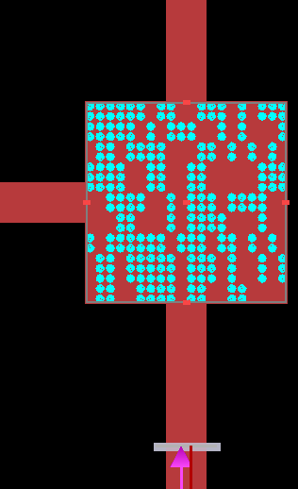
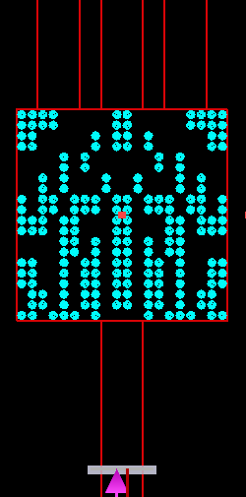
Last Week
This Week
Cross Splitter
1-Input 3-Output Splitter
1-Input 3-Output Splitter
Network algorithm

Slide 2
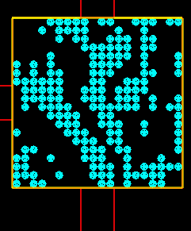
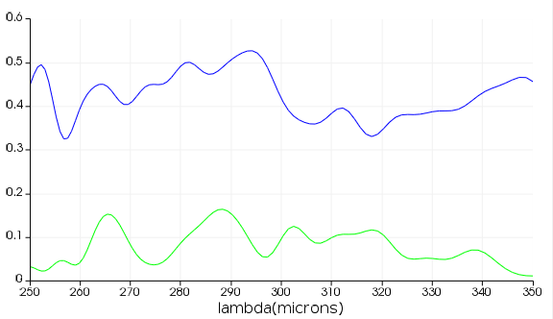
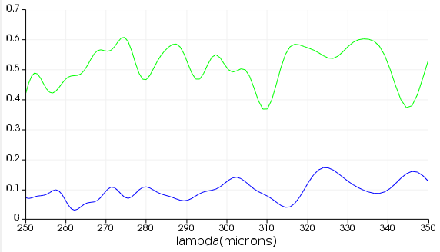
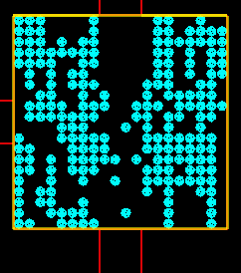
Cross Power Splitter – Result
Data
T₁ max = 0.3
T₂ max = 0.5
FOM = T₁
T₂
T₁
T₁
T₂
Input
FOM = norm(T₁) +norm( T₂)
T₂
T₂
T₁
T₁
Input

Slide 3
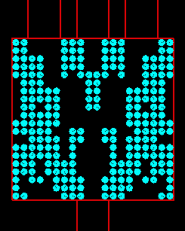
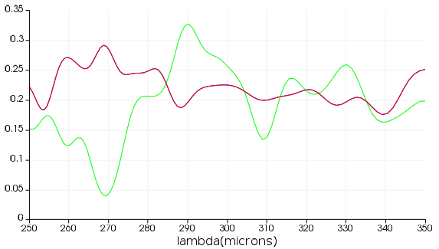
1-Input 3-Output Splitter – Result
FOM = T₁+T₂+T₃
T₁
T₂
T₃
T_{1,3}
T₂
Input

Slide 4
Algorithm
Artificial Intelligence
Machine Learning
Deep Learning
Machine Learning:
A computer program is said to learn from experience E with respect to some class of tasks T and performance measure P if its performance at tasks in T , as measured by P, improves with experience E.
Deep Learning:
Deep learning is a particular kind of machine learning that achieves great power and flexibility by learning to represent the world as nested hierarchy of concepts, with each concept defined in relation to simpler concepts, and more abstract representations computed in terms of less abstract ones

Slide 5
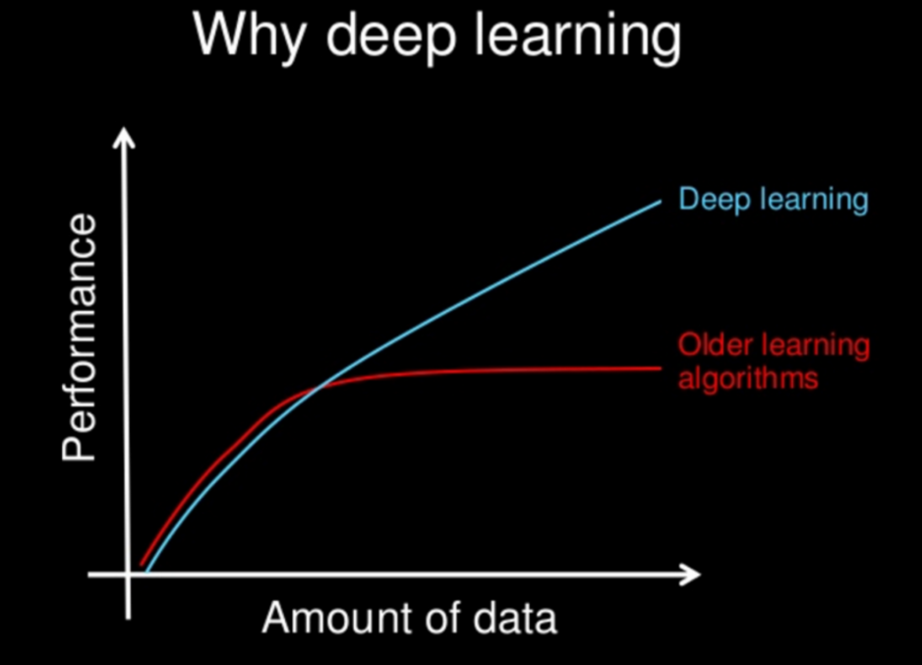
Algorithm
Find Square
Features: 4 corners, 4 lines and closed or not
Machine Learning:
Need features
Deep Learning:
Find features itself

Slide 6
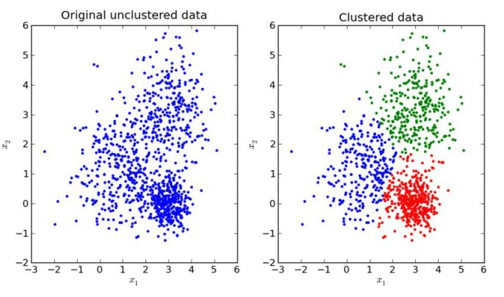
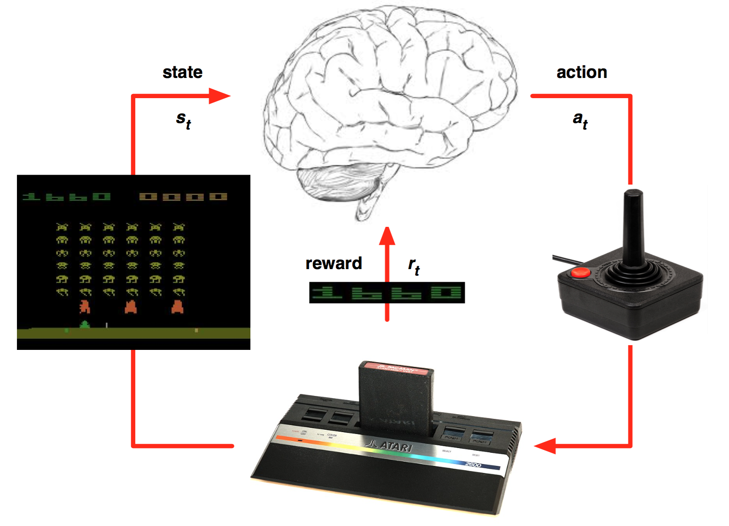
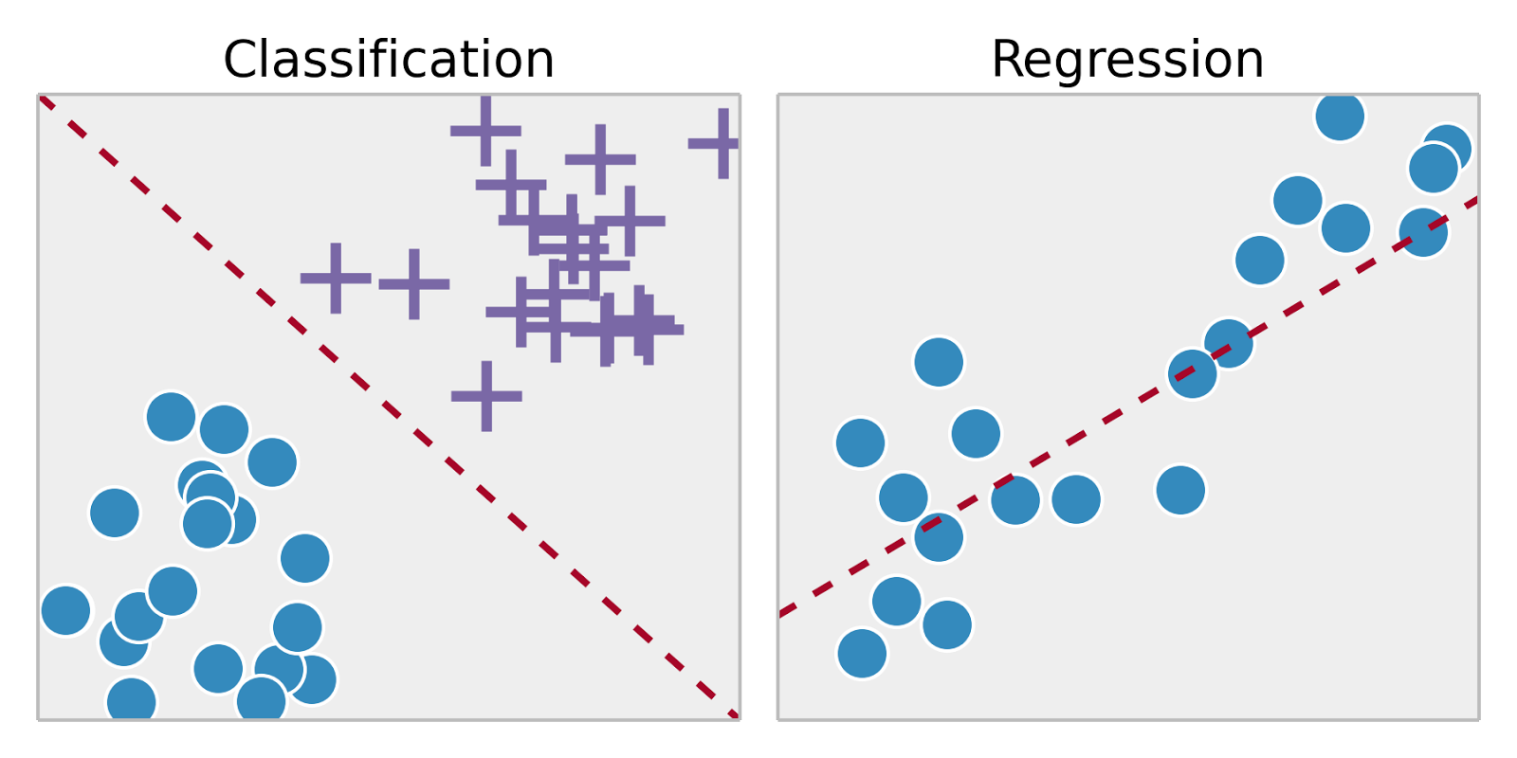
Algorithm
Deep Learning
Supervised
Learning
Unsupervised Learning
Reinforcement
Learning
Classification, Regression
Clustering, recommendation
Reward(FOM) maximization

Slide 7
2D Power Splitter – Algorithm
Without Nerual Network, Reinforcement Learning
ARLA (Additive Reinforcement Learning Algorithm)
=> 현재 사용 중인 알고리즘
With Neural Network, Supervised Learning Regression
FCDNN (Fully Connected Deep Neural Network)
ResNet (Residual Network)
DenseNet (Dense Network)
=> 구현 중

Slide 8
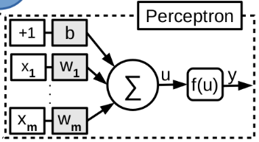
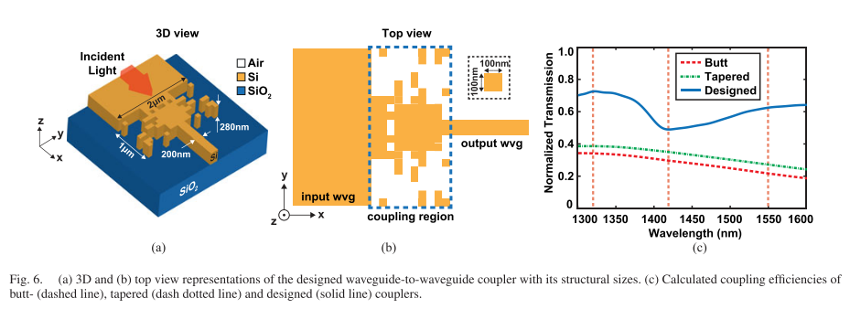
Algorithm without Neural Network
Without Nerual Network, Reinforcement Learning
ARLA (Additive Reinforcement Learning Algorithm)
Training
Data
Result
Structure
Algorithm
Algorithm ref. : Çağrı Latifoğlu, “Binary Matrix Guessing Problem,” arXiv:1701.06167 [cs.AI], 2018
Application ref. : Mirbek Turduev et al. “Ultracompact Photonic Structure Design for Strong Light Confinement and Coupling Into Nanowaveguide,” Journal of Lightwave Technology, 2018

Slide 9
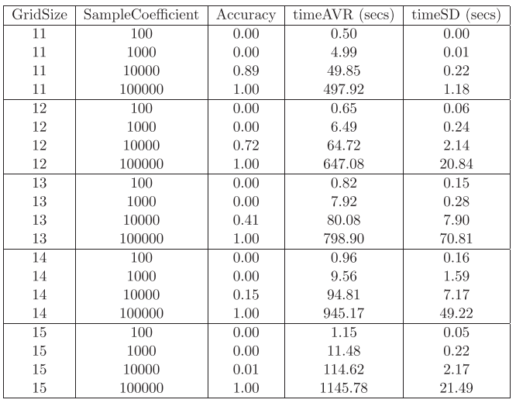
Additive Reinforcement Learning Algorithm (ARLA) Example
0 | 1 | 1 | 0 | 1
Sequences
scores
Sequences * scores
1 | 0 | 1 | 0 | 1
5-2=3
3 | 0 | 3 | 0 | 3
0 | 1 | 0 | 1 | 0
5-3=2
Sequence * score
0 | 2 | 0 | 2 | 0
Sum
0 | 0 | 1 | 0 | 0
5-2=3
0 | 0 | 3 | 0 | 0
0 | 1 | 1 | 1 | 1
5-1=4
0 | 4 | 4 | 4 | 4
Substract min.(=3)
3 | 6 | 10 | 6 | 7
0 | 3 | 7 | 3 | 4
Average = 3.4
e_{i}> average: 1
e_{i}< average: 0
Result sequence
score
0 | 0 | 1 | 0 | 1
5-1=4

Slide 10
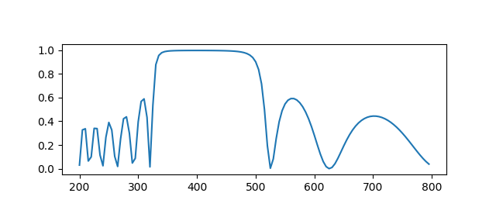
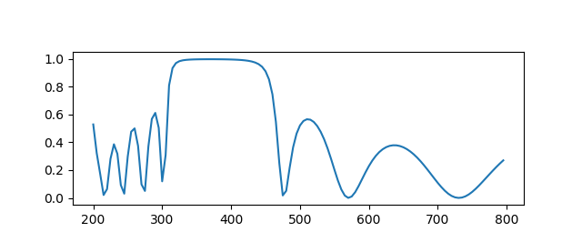
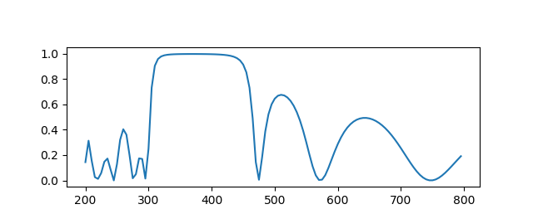



DBR(ARLA) - Result
N_{pixel}: 100, dx: 5 nm, n_{h}: 2.681 (TiO₂), n_{l}: 1.470 (SiO₂)
$$L=N_{pixel}∗dx$$
Theory
R_{out}
R_{in}
R_{out}
$$dx$$
$$i$$
Reflectivity
…
Wavelength [nm]
ARLA_R_{in} / R_{out}
ARLA_R_{in}*(1-R_{out})
 | score | FWHM | Thickness (nm)
Theory [R_{in} / R_{out}] | 2.167 | 195 | 37, 68, 37, 68, 37, 68, 37, 68, 37, 68, 37
Theory [R_{in}*(1-R_{out})] | 0.538
R_{in} / R_{out} | 2.280 | 165 | 5, 45, 50, 40, 45, 40, 50, 40, 45, 40, 50, 45
R_{in}*(1-R_{out}) | 0.546 | 165 | 10, 40, 45, 45, 45, 40, 50, 40, 45, 45, 45, 40

Slide 11
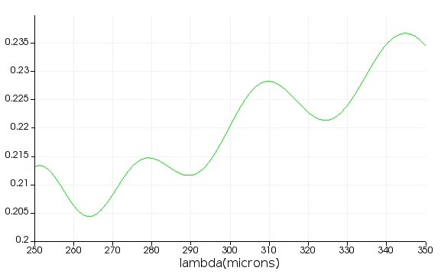
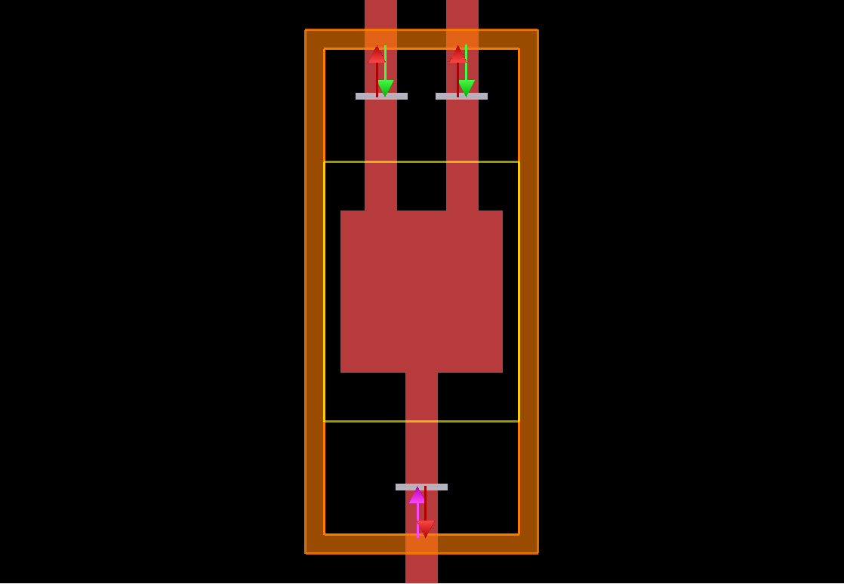
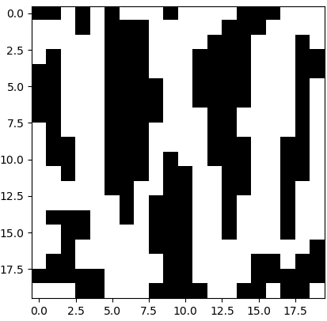
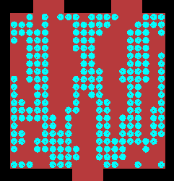
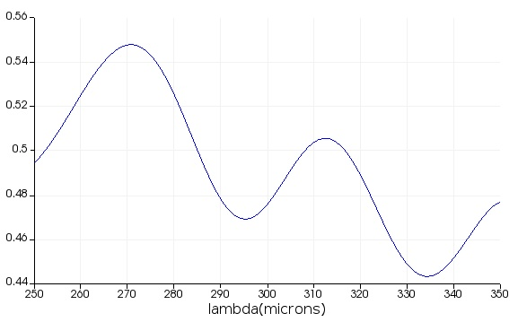
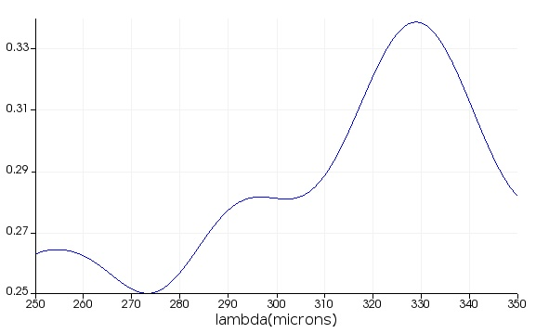
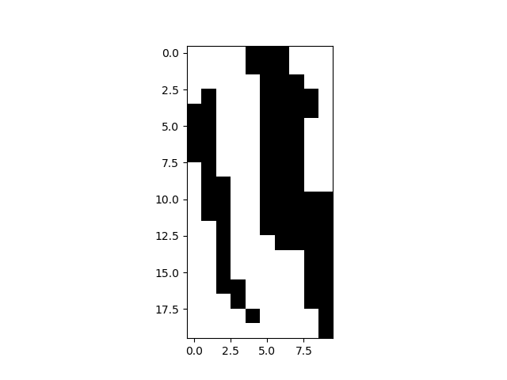
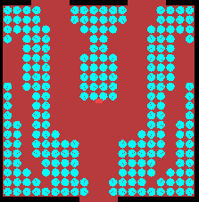
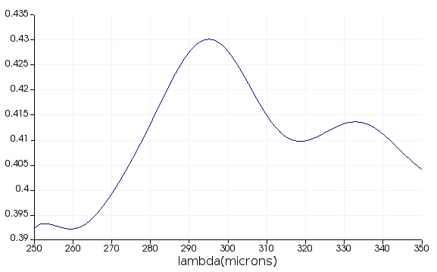
2D Power Splitter(ARLA) – Result
random
T₁
T₂
T₁ ~0.5
T₂ ~ 0.3
symmetry
T₁
T₂
T₁ ~0.41
T₂ ~0.41

Slide 12
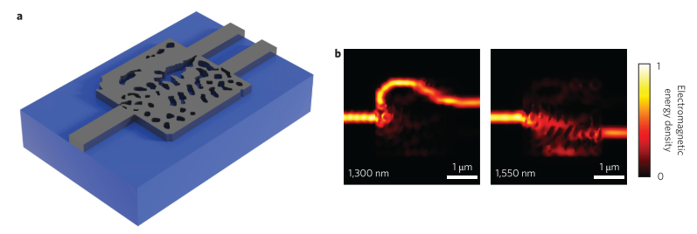

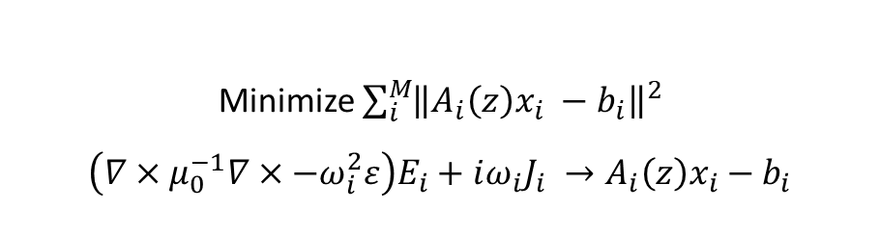
Algorithm with Neural Network, Supervised Learning Regression
Inverse design
Inverse design
structure
$$f\left(x\right)$$
spectrum
Ex. T-matrix, FDTD
Minimize $\sum_{i}^{M}{{\left\|A_{i}\left(z\right)x_{i} −b_{i}\right\|}^{2}}$
$$\left(∇×μ_{0}^{−1}∇×−ω_{i}^{2}ε\right)E_{i}+iω_{i}J_{i} →A_{i}\left(z\right)x_{i}−b_{i}$$
ref. : A. Piggott, J. Lu, Lagoudakis et al. “Inverse design and demonstration of a compact and broadband on-chip wavelength demultiplexer," Nature Photonics, 2015

Slide 13
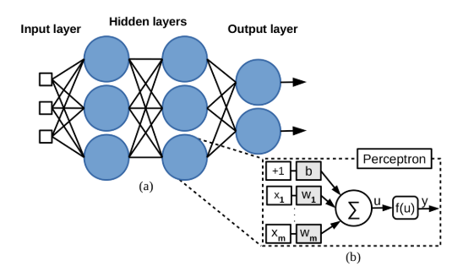

Algorithm with Neural Network
With Neural Network
FCDNN (Fully Connected Deep Neural Network)
ResNet (Residual Network)
DenseNet (Dense Network)
$$f\left(x\right)=g\left(x\right)+n(x)$$
FDTD
Simulation
Neural
Network
error
Forward design
Inverse design
Initial
structure
Neural
Network
Result
Structure
Optimizer
Iteration
FCDNN ref.1 : A. da Silva Ferreira et al. "Computing Optical Properties of Photonic Crystals by Using Multilayer Perceptron and Extreme Learning Machine," Journal of Lightwave Technology, 2018
FCDNN ref.2 : Dianjing Liu et al. “Training Deep Neural Networks for the Inverse Design of Nanophotonics Structures," ACS Photonics, 2018
ResNet ref. : Mohammd H. Tahersima et al. “Deep Neural Network Inverse Design of Integrated Photonic Power Splitters,” Scientific Reports, 2019

Slide 14
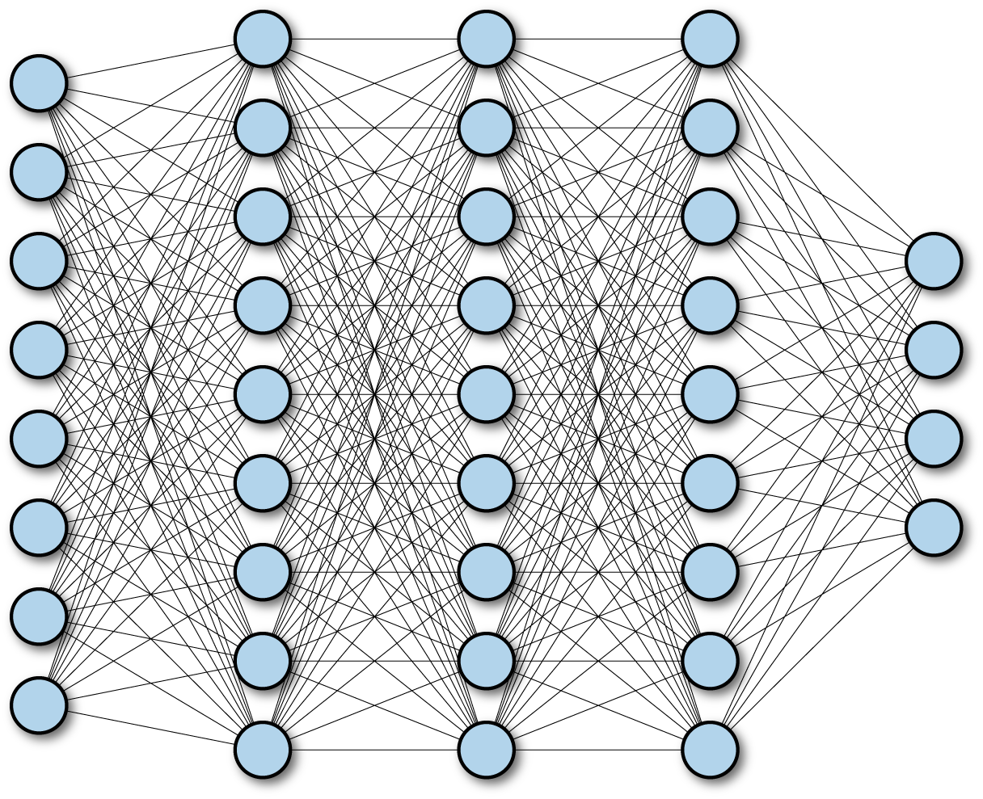
Neural Netowrk
FCDNN (Fully Connected Deep Neural Network)
Layer
Input
Output
ResNet (Residual Network)
Layer
1
Layer
2
Layer
3
Layer
4
Input
+
+
Output
DenseNet
Dense Block
Layer
1
Layer
2
Layer
3
Layer
4
Input
[+]
[+]
[+]
[+]
Output

Slide 15
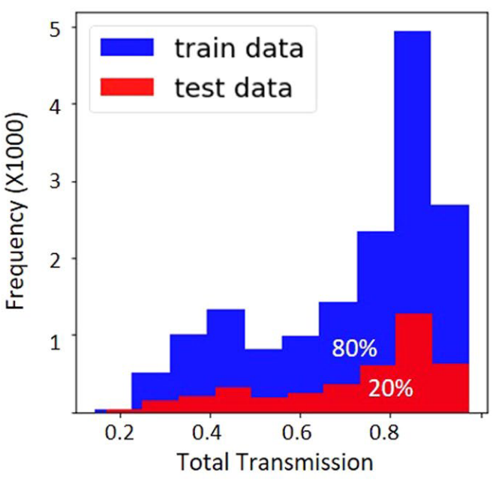
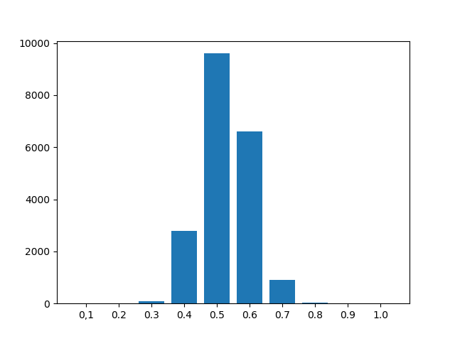
Algorithm with Neural Network
With Neural Network
FCDNN (Fully Connected Deep Neural Network)
ResNet (Residual Network)
DenseNet (Dense Network)
Frequency
Total Transmission
Mohammd H. Tahersima et al. “Deep Neural Network Inverse Design of Integrated Photonic Power Splitters,” Scientific Reports, 2019

Slide 16
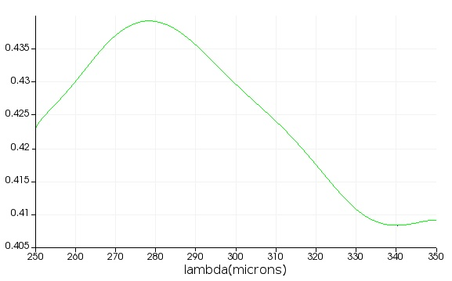
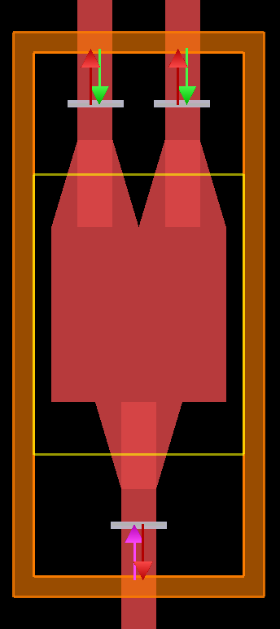
2D Power Splitter – FDTD Setting
Output 1&2
(b)-1
(a)-1
(a)-2
~ 0.4
(b)-2
~ 0.2
Simulation region: 250 ~ 350 um
Waveguide thickness: 100 um
Square: 500 um x 500 um
Taper connection: 250 um
Holes: 20x20 with a radius of 9 um

